Slide 1
Multiple Imputation in Stata: A Brief Tutorial
Samuel E DeWitt

Slide 2
Introduction
A big ol' caveat at the outset!
I am by no means an expert in multiple imputation, but I do have some limited experience that I will share today using a simple data set from the NLSY97.
Much of this is based on a lecture Robert Apel delivered when I was still a student at Rutgers (in what we call the before times)
He gets a good deal of the credit here, especially for all of the mistakes.

Slide 3
Other (Better!) Resources
People much smarter than me (and Bob) have written textbooks on this, so please consult those before relying strictly on what I present here.
Little and Rubin (2002), Statistical Analysis with Missing Data
Rubin (1987), Multiple Imputation for Nonresponse in Surveys
Schafer (1997), Analysis of Incomplete Multivariate Data
There are newer resources out there, but these are some foundational explorations on the topic of imputing missing values

Slide 4
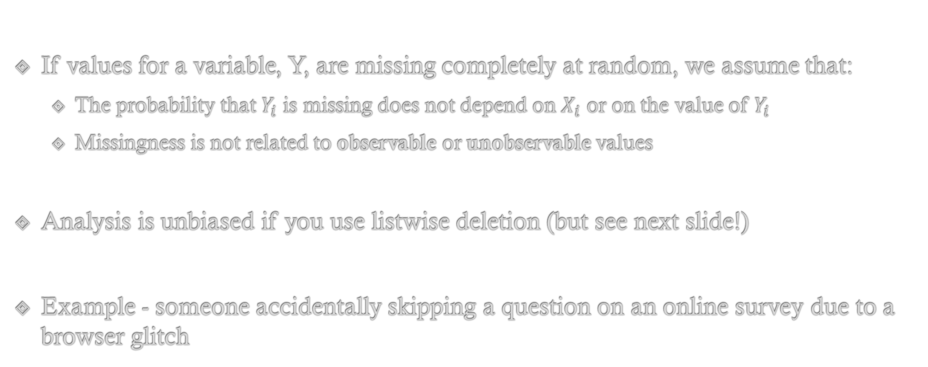
Defining Missingness: Missing Completely At Random (MCAR)
If values for a variable, Y, are missing completely at random, we assume that:
The probability that $Y_{i}$ is missing does not depend on $X_{i}$ or on the value of $Y_{i}$
Missingness is not related to observable or unobservable values
Analysis is unbiased if you use listwise deletion (but see next slide!)
Example - someone accidentally skipping a question on an online survey due to a browser glitch

Slide 5
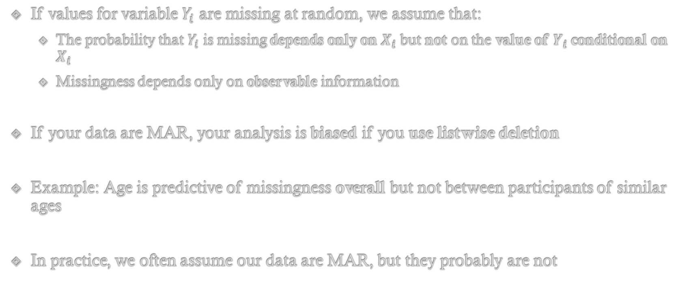
Defining Missingness: Missing At Random (MAR)
If values for variable $Y_{i}$ are missing at random, we assume that:
The probability that $Y_{i}$ is missing depends only on $X_{i}$ but not on the value of $Y_{i}$ conditional on $X_{i}$
Missingness depends only on observable information
If your data are MAR, your analysis is biased if you use listwise deletion
Example: Age is predictive of missingness overall but not between participants of similar ages
In practice, we often assume our data are MAR, but they probably are not

Slide 6
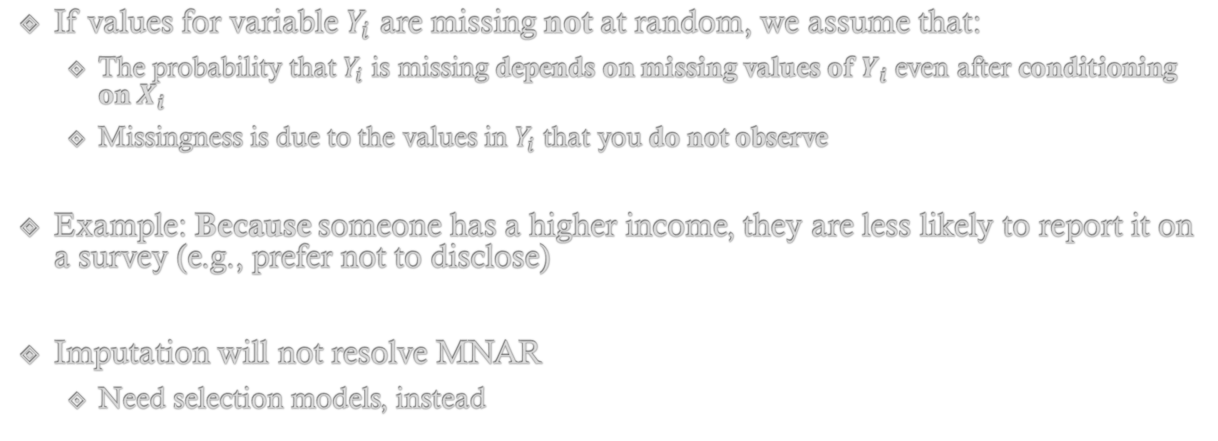
Defining Missingness: Missing Not at Random (MNAR)
If values for variable $Y_{i}$ are missing not at random, we assume that:
The probability that $Y_{i}$ is missing depends on missing values of $Y_{i}$ even after conditioning on $X_{i}$
Missingness is due to the values in $Y_{i}$ that you do not observe
Example: Because someone has a higher income, they are less likely to report it on a survey (e.g., prefer not to disclose)
Imputation will not resolve MNAR
Need selection models, instead

Slide 7
How Do I Tell Which Definition Applies?
Little’s MCAR test
This can at least rule out MCAR for you, but it’s unlikely you meet that assumption anyway
I’ll show you how to do this in Stata momentarily (uses mcartest function)
Ruling out MAR
You can estimate logistic regressions
Need to dummy code variables with missing data (missing = 1, otherwise = 0)
Then, estimate models including all other predictors, rotating outcomes as needed
Another option is to use the misstable summarize/misstable patterns functions to visually inspect your data
Ruling out MNAR
If you figure this out, let me know. (but seriously, selection models are your best bet)

Slide 8
Typical Approaches to Missing Data
Standard solutions for missing data
Listwise deletion (complete case analysis)
Mean imputation of missing values (continuous) or inclusion of separate dummy variable for missing values (categorical)
Or “zero” imputation along with dummy variable flag
These solutions assume that missing values are either ignorable (MCAR) or are known from variables with complete data (MAR)

Slide 9
Multiple Imputation Solution
“Draws” a hypothetical value for missing cases, and then performs these draws multiple times
Generates a predicted value from a regression model, and then adds a random error to this predicted value
Treats imputed value(s) as uncertain and then adjusts variance estimates accordingly
Uses all available information from the sample
Dependent and independent variables; past and future values; included and excluded covariates

Slide 10
Steps in Multiple Imputation
1) Create m = 1,..,M copies of the original dataset in which all missing values are imputed
M = 5 at a minimum, but should be 10+ if missingness is a large problem
2) Apply standard regression analysis to each of the M imputed datasets
3) Adjust parameter estimates derived from the M analyses and draw inferences

Slide 11
Multiple Imputation in Stata
Stata’s suite of mi commands
mi set = Choose storage style for imputed data
Long vs. wide
mi register = Declare the kinds of variables that exist in the dataset
Regular vs. imputed
mi impute = Impute missing values
mi estimate = Analyze imputed datasets and combine results

Slide 12
Multiple Imputation in Stata (cont)
Multiple imputation using chained equations (MICE) method
Allows arbitrary (i.e., non-monotonic) missing data patterns and selection of a different probability model for different variables
Continuous = Linear regression, censored regression, predictive mean matching (non-parametric)
Categorial = Logistic, ordered, multinomial
Count = Poisson, negative binomial
Sequential imputation, starting with the variable containing the least amount of missing data

Slide 13
Performing MICE in Stata
Performing M.I.C.E. in Stata
mi impute chained (model1) zvar1 zvar2 (model2) zvar3 zvar4 = xvar1 xvar2 xvar3, add(M) rseed(num)
“zvar#” = Variable with missing values
“xvar#” = Variable with complete information
“model#” = Probability model for specified variable
“M” = Number of imputations
“num” = Seed for random number generator

Slide 14
Example Data: NLSY97
bmi_{i} = Body mass index
male_{i} = 1 if respondent is male
white_{i} = 1 if respondent is white, non-Hispanic
age_{i} = Age at interview (12-18)
hh_size_{i} = Household size (1-16)
health_{i} = Self-report rating of health (1 “Excellent” to 5 “Poor”)
n_marij_{i} = Number of days smoked marijuana in the last 30 days (0-30)

Slide 15
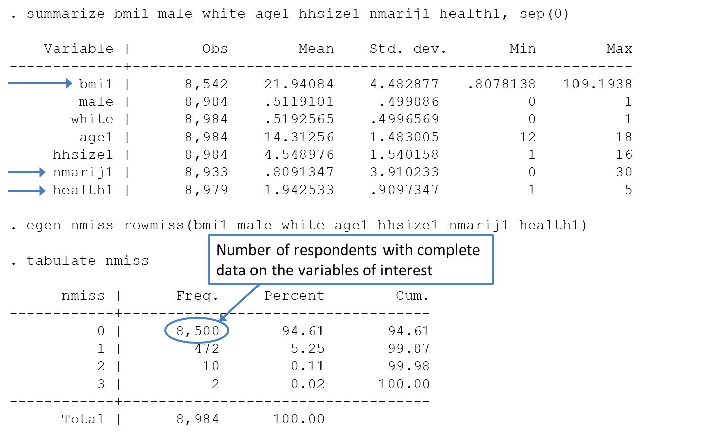
Summary of Missingness

Slide 16
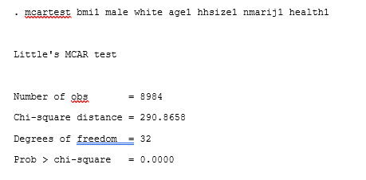
Little’s MCAR Test

Slide 17
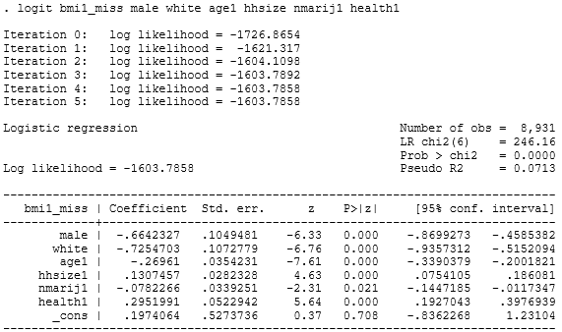
Logistic Regression MAR Tests

Slide 18
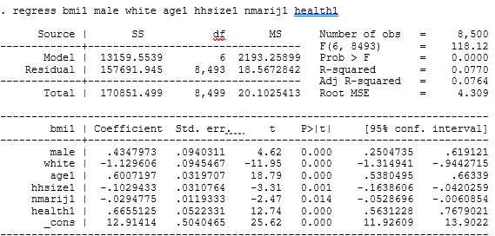
Complete Case Analysis

Slide 19
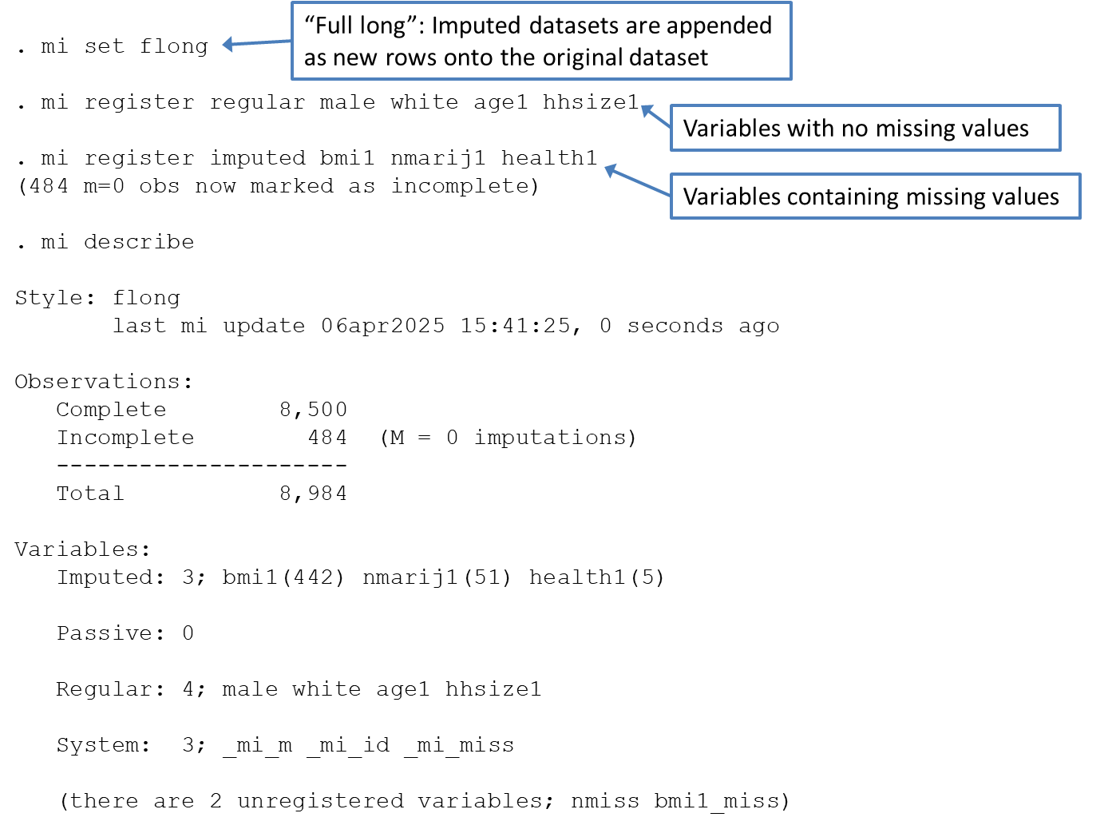
Setting Imputation Parameters

Slide 20
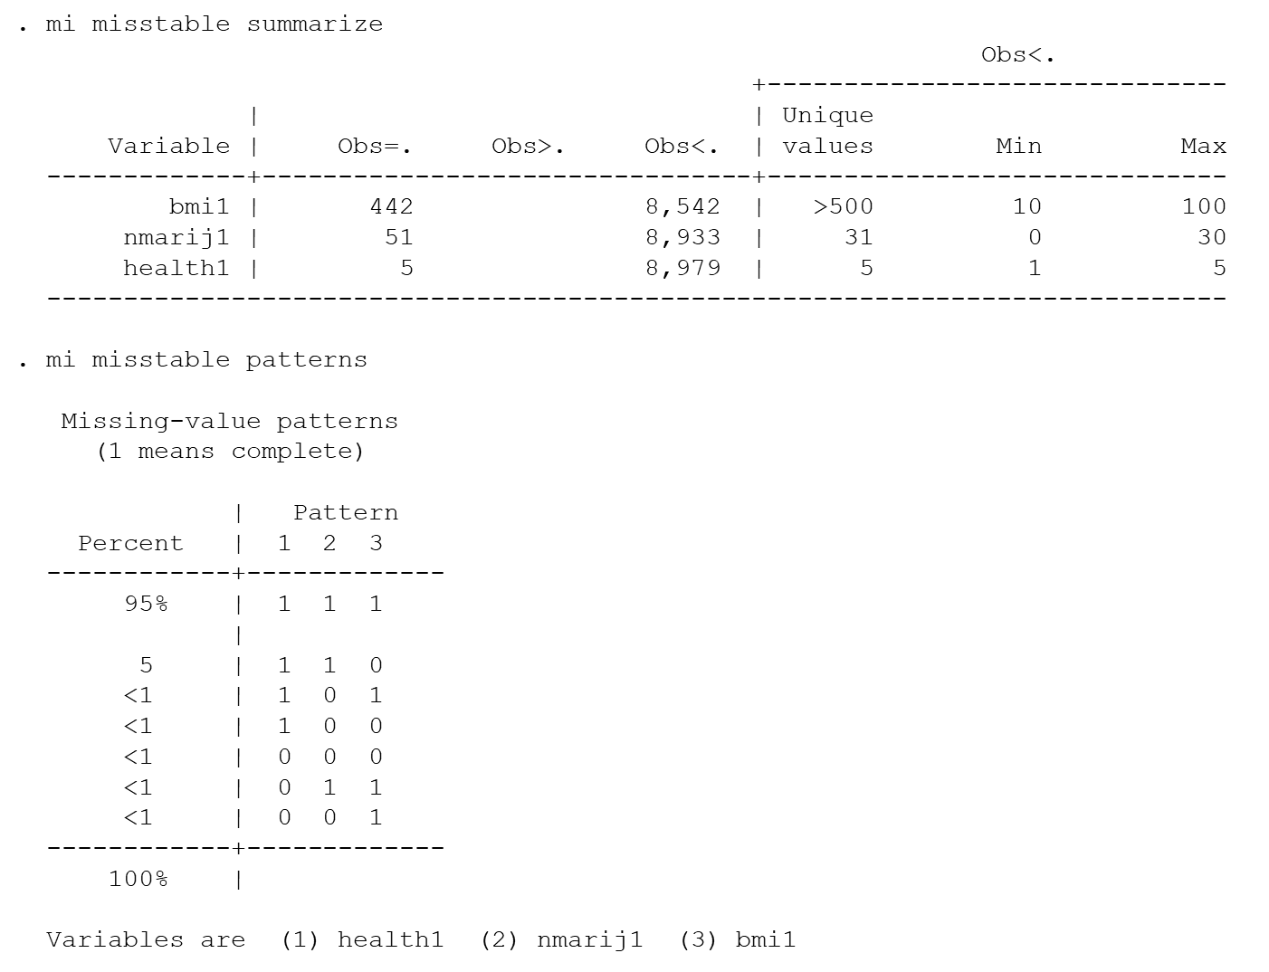
Using Misstable to Summarize Missingness

Slide 21
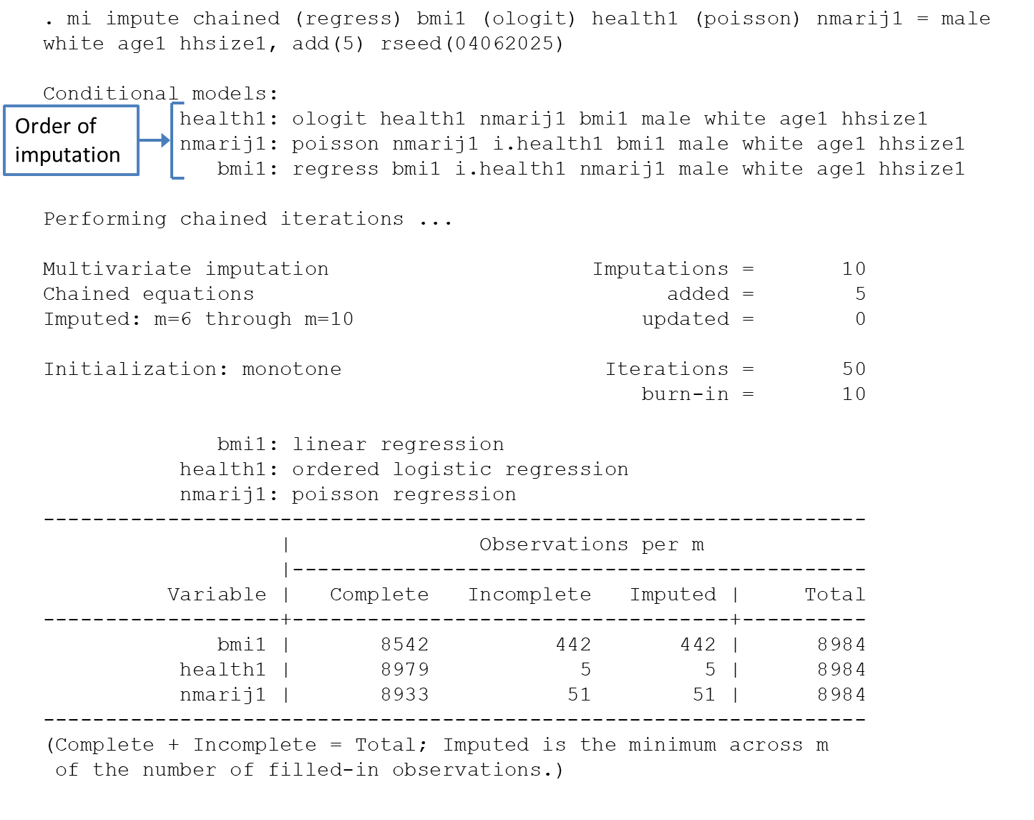
Running the Imputation Models

Slide 22
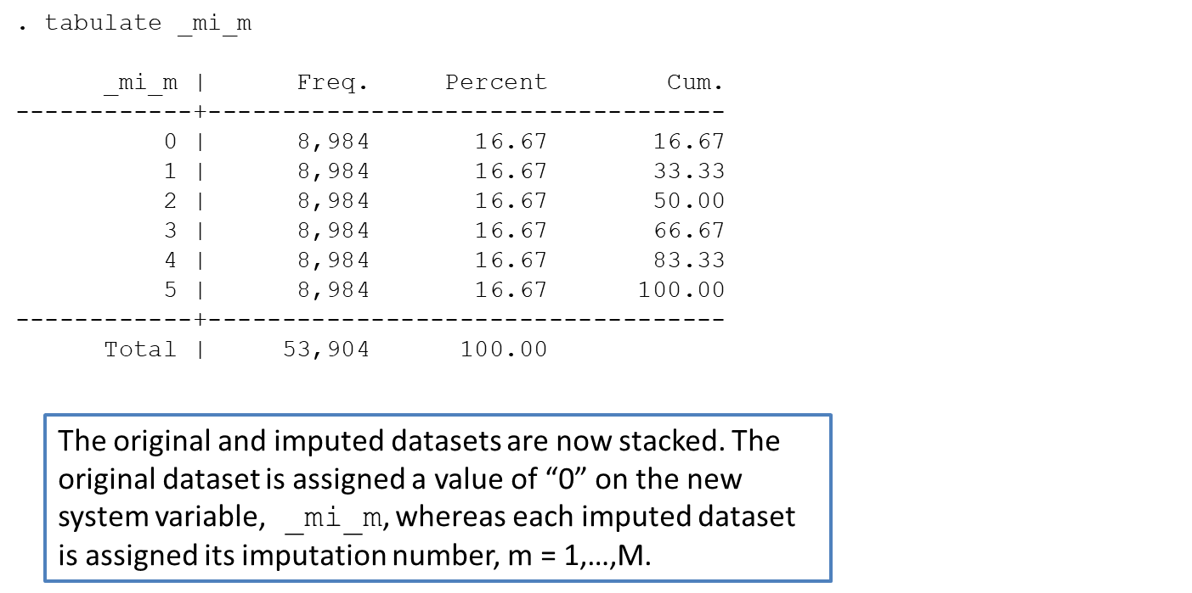
How Are the Different Data Sets Stored?

Slide 23
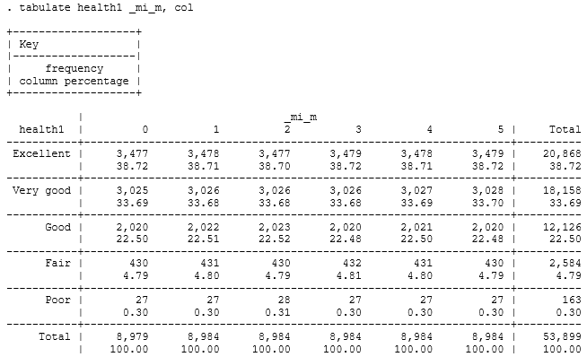
Inspecting the Health Variable Across Imputed Data Sets
Original dataset
Imputed datasets with which analysis will be performed

Slide 24
Distributions of Imputed BMI Values
twoway (kdensity bmi1 if bmi1>15 & bmi1<35 & _mi_m==1) ///
(kdensity bmi1 if bmi1>15 & bmi1<35 & _mi_m==2) ///
(kdensity bmi1 if bmi1>15 & bmi1<35 & _mi_m==3) ///
(kdensity bmi1 if bmi1>15 & bmi1<35 & _mi_m==4) ///
(kdensity bmi1 if bmi1>15 & bmi1<35 & _mi_m==5, ///
legend(off) scheme(gg_tableau)), ///
xtitle("BMI Value") ytitle("Kernal Density")

Slide 25
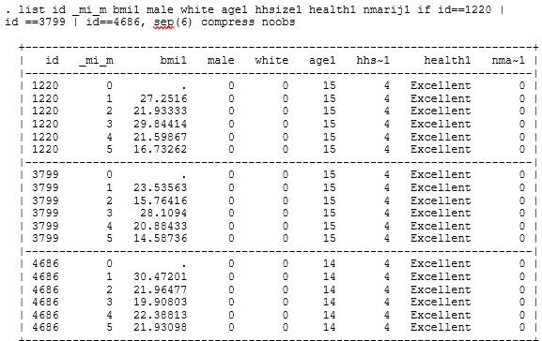
Taking a Closer Look at Three Youth’s Values
These 3 respondents have missing BMI but are otherwise identical on the remaining covariates. With standard imputation, they would be assigned the same value for BMI. But with multiple imputation, they receive independent random “draws” from the conditional distribution of BMI.

Slide 26
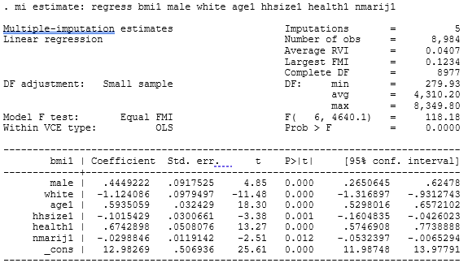
Estimate the Multiply Imputed Regression Models
There is some indication in the Stata literature that the best performance of the multiple imputation model (in the sense of minimizing simulation error and getting stable estimates) is achieved when M ≈ 10 × largest F.M.I. (fraction missing information)

Slide 27
Multiple Imputation Results
Regressor | 1 | 2 | 3 | 4 | 5
Intercept | 12.82 (.49)*** | 13.06 (.49)*** | 13.14 (.49)*** | 12.92 (.49)*** | 12.98 (.49)***
Male | 0.44 (.09)*** | .44 (.09)*** | .46 (.09)*** | .44 (.09)*** | .44 (.09)***
White | -1.15 (.09)*** | -1.12 (.09)*** | -1.14 (.09)*** | -1.07 (.09)*** | -1.14 (.09)***
Age | .61 (.03)*** | .59 (.03)*** | .58 (.03)*** | .59 (.03)*** | .60 (.03)***
Household Size | -0.10 (.03)** | -.10 (.03)** | -.10 (.03)** | -.10 (.03)** | -.11 (.03)***
Health Rating | .67 (.05) *** | .68 (.05)*** | .67 (.05)*** | .68 (.05)*** | .67 (.05)***
Marijuana Use | -.03 (.01)*** | -.03 (.01)* | -.03 (.01)* | -.03 (.01)* | -.03 (.01)*
N | 8,984 | 8,984 | 8,984 | 8,984 | 8,984

Slide 28
Multiple Imputation in Stata: A Brief Tutorial
Samuel E DeWitt

